Slide 1
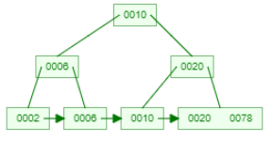
B+ Trees
Illustrative Example
of
Inserting a Node in a
B+ tree

Slide 2
B+ Trees
In B Tree, Keys and records both can be stored in the internal as well as leaf nodes. Whereas, in B+ tree, records (data) can only be stored on the leaf nodes while internal nodes can only store the key values.
The leaf nodes of a B+ tree are linked together in the form of a singly linked lists to make the search queries more efficient.
B+ Tree are used to store the large amount of data which can not be stored in the main memory.

Slide 3
B+ Tree
B+ Tree is an extension of B Tree which allows efficient insertion, deletion and search operations.
In B Tree, Keys and records both can be stored in the internal as well as leaf nodes. Whereas, in B+ tree, records (data) can only be stored on the leaf nodes while internal nodes can only store the key values.
The leaf nodes of a B+ tree are linked together in the form of a singly linked lists to make the search queries more efficient.
B+ Tree are used to store the large amount of data which can not be stored in the main memory.
Due to the fact that, size of main memory is always limited, the internal nodes (keys to access records) of the B+ tree are stored in the main memory whereas, leaf nodes are stored in the secondary memory

Slide 4
The internal nodes of B+ tree are often called index nodes.
A B+ tree of order 3 is shown in the following figure.

Slide 5
Insertion in B+ Tree
Step 1: Insert the new node as a leaf node
Step 2: If the leaf doesn't have required space, split the node and copy the middle node to the next index node.
Step 3: If the index node doesn't have required space, split the node and copy the middle element to the next index page.

Slide 6
Insert 2, 6, 10, 20, 78, 5, 90 in B+ Tree of order 3

Slide 7

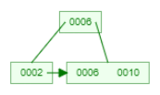

Insert 2, 6, 10, 20, 78, 5, 90,
Insert 2, 6,
Insert 10
Insert 20

Slide 8
Insert 2, 6, 10, 20, 78, 5, 90,
Insert 78

Slide 9
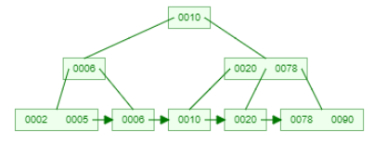
Insert 2, 6, 10, 20, 78, 5, 90,
Insert 5, 90

Slide 10
B+ Tree of order 3
Insert 2, 6, 10, 20, 78, 5, 90,
Insert 2, 6,
Insert 10
Insert 78
Insert 20
Insert 5, 90

Slide 11
Insert 10, 9, 8, 11, 7, 5, 6, 26, 3, 13
B+ Tree of order 3

Slide 12
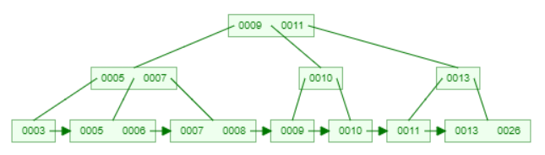
Insert 10, 9, 8, 11, 7, 5, 6, 26, 3, 13
B+ Tree of order 3

Slide 13
Deletion in B+ Tree
Illustrative Example
of
Deleting a Key in a
B+ tree

Slide 14
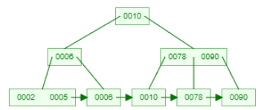
Delete 20, 10, 6
Delete 20

Slide 15
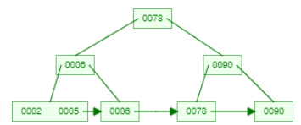
Delete 20, 10, 6
Delete 10

Slide 16
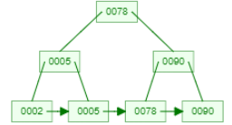
Delete 20, 10, 6
Delete 6

Slide 17
Delete 20, 10, 6
Delete 20
Delete 10
Delete 6

Slide 18
Advantages of B+ Tree
Records can be fetched in equal number of disk accesses.
Height of the tree remains balanced.
We can access the data stored in a B+ tree sequentially as well as directly.
Keys are used for indexing.
Faster search queries as the data is stored only on the leaf nodes.

Slide 19
B Tree VS B+ Tree
SN | B Tree | B+ Tree
1 | Search keys can not be repeatedly stored. | Redundant search keys can be present.
2 | Data can be stored in leaf nodes as well as internal nodes | Data can only be stored on the leaf nodes.
3 | Searching for some data is a slower process since data can be found on internal nodes as well as on the leaf nodes. | Searching is comparatively faster as data can only be found on the leaf nodes.
4 | Deletion of internal nodes are so complicated and time consuming. | Deletion will never be a complexed process since element will always be deleted from the leaf nodes.
5 | Leaf nodes can not be linked together. | Leaf nodes are linked together to make the search operations more efficient.

Slide 20
Video Lectures can be found at following link
B Tree
https://youtu.be/Or7BViYrov0
Illustrative Examples of Inserting a Node in a B+ tree
https://youtu.be/3Hq7k6CT450
Illustrative Examples of Deleting a Node in a B+ tree
https://youtu.be/1ejTf2y8_nE
Use link for More Practise
https://www.cs.usfca.edu/~galles/visualization/BTree.html
https://www.cs.usfca.edu/~galles/visualization/BPlusTree.html
https://www.cs.usfca.edu/~galles/visualization/AVLtree.html

